Slide 1







HUMAN VIOLENCE DETECTION USING VIDEOS
Computer Vision Final Project

Slide 2



Table of Contents
1
Background and Motivation
2
Problem Identification
3
Related Work
4
Methodology and Results
5
Challenges
6
Conclusion
1

Slide 3


1/ Background and Motivation
Violence in public areas can seriously jeopardize public safety, including streets, malls, and schools. Conventional surveillance camera monitoring techniques depend on human operators, who might not always notice problems in a timely manner. Real-time alerts can be provided by AI-based systems that automatically scan video feeds, identify violent activity, and immediately notify the appropriate authorities.
2

Slide 4


2/ Problem Identification
Manual surveillance struggles with real-time violence detection, leading to delays and errors. The task is to develop an automated system that can accurately classify violent and non-violent actions in short video clips.
Input: a short video clips
Output: A binary classification indicating whether the video contains violent or non-violent behavior. The system will use deep learning models to process spatial and temporal video data for efficient, real-time violence detection.
3

Slide 5
3/ Related Work
Video Datasets for Violence Detection
Early datasets like Hockey Fight and Movies Fight: Limited in size and diversity, focusing on specific contexts (sports, movies).
Crowd Violence:
Highlighted crowded environments but suffered from low image quality.
Recent datasets like CCTV-Fights and UCF-Crime: Introduced real-world surveillance videos but had issues like long durations and coarse annotations.
RWF-2000 Dataset:
Contains 2,000 trimmed clips of real-world violent incidents captured by security cameras.
Balanced categories (violent/non-violent) and ensures minimal training/test overlap.
4

Slide 6
3/ Related Work
Methods for Violence Detection
Traditional Approaches:
Used handcrafted features (e.g., iDT, MoSIFT, STIPs) with shallow classifiers (e.g., SVM).
Worked well for simple cases but lacked generalization.
Deep Learning Approaches:
Popular architectures: ConvLSTM, C3D, Two-Stream Networks.
Combine spatial and temporal features, often using RGB and optical flow inputs.
Require diverse datasets to mitigate overfitting but outperform traditional methods.
5

Slide 7
3/ Related Work
Gaps Identified
High computational costs (e.g., 3D CNNs, optical flow).
Dependency on noisy data (e.g., raw video frames with background noise).
Challenges in real-time processing.
How This Paper Advances the Field
Simplifies input by focusing on skeletons (essential body movements) and frame differences (inter-frame dynamics).
Combines both pipelines using an addition-based fusion for robustness against pipeline failures.
Uses ConvLSTM for efficient spatio-temporal aggregation with fewer parameters.
Achieves real-time performance with superior accuracy compared to prior models.
6

Slide 8
Depend heavily on manual feature engineering (e.g., STIP, MoSIFT).
Limited ability to generalize to diverse scenarios or unseen data.
Computationally expensive and unsuitable for real-time processing.
Performance degrades in crowded or noisy environments.
3/ Related Work
Classical Approaches
3D CNNs:
Posed-based Approaches
Skeleton Points Interaction Learning (SPIL):
Deep learning Approaches
Feature-Based Methods:
Violent Flow Descriptions:
Hybrid models:
Two stream models:
Pose-Driven Fusion:
MoSIFT: Combines SIFT descriptors with motion information.
Spatio-Temporal Interest Points (STIP) : Detects significant intensity variations in space and time.
Violent Flows (ViF): Analyzes optical flow changes over time.
Oriented Violent Flows (OViF): Adds flow orientation for improved performance in uncrowded scenarios.
Li et al. (2019): Introduces an efficient 3D CNN with reduced kernel size.
Ding et al. (2014): Extends 2D CNNs for spatio-temporal feature extraction but increases model complexity.
CNN + LSTM: Combines spatial feature extraction with temporal sequence analysis.
ConvLSTM: Uses convolutional LSTMs for spatial and temporal aggregation.
Flow Gated Networks: Combines spatial and temporal pipelines with optical flow.
Separable ConvLSTM: Processes raw videos and frame differences independently.
Proposed by Su et al. (2020): Uses Graph Neural Networks to analyze human skeletons and their interactions.
Combines pose and temporal features for enhanced violence detection.
Require a large number of parameters, increasing computational cost (overfitting)
CNN + LSTM models lose spatial information during the transition to temporal processing.
Common fusion techniques (e.g., concatenation, element-wise multiplication) do not fully leverage complementary information from spatial and temporal streams
Risk of signal loss when one stream provides zero-valued outputs.
Accuracy is sensitive to the quality of pose estimators (e.g., SPIL by Su et al., 2020).
Struggle in occluded or crowded environments where pose estimation fails.
7

Slide 9

3/ Methodology and Results
3.1
Dataset
3.2
Preprocessing
3.3
Model Development
3.4
CNN-LSTM
3.5
Video ViT
3.6
Human Skeleton and change difference
8

Slide 10
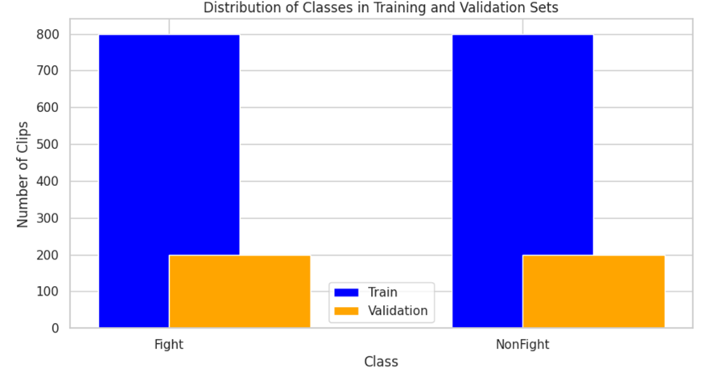
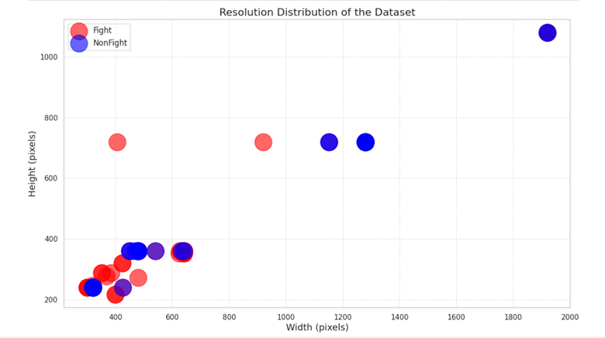

3.1/ Dataset
The Dataset: RWF2000 - A Large Scale Video Database for Violence Detection
The training set contains 800 clips for each category, and the validation set has 200 clips for each, indicating a perfectly balanced distribution
=> This balance helps ensure that the dataset is well-suited for training a classification model without issues related to class imbalance
Most data points are clustered between 300-800 pixels in width and 200-600 pixels in height, suggesting standard or low-resolution surveillance footage. Higher-resolution videos are fewer, appearing as distinct points around 1200-2000 pixels in width
The overlap between "Fight" and "NonFight" classes in low resolutions implies similar video quality for both categories
9

Slide 11
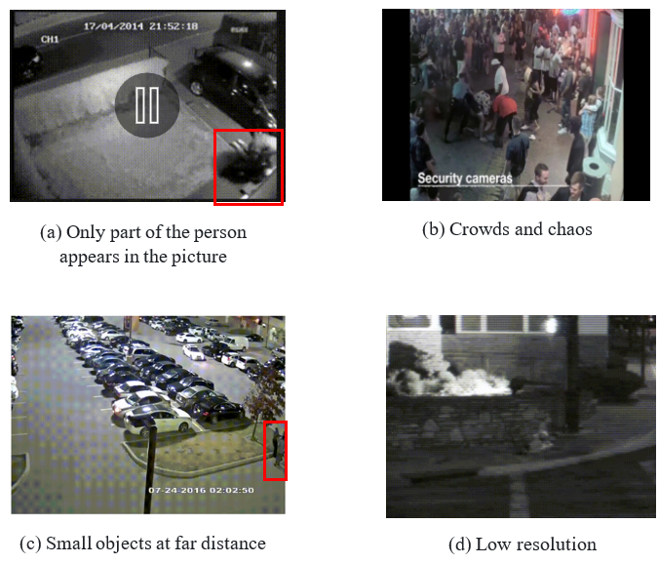
3.1/ Dataset
Dataset Problems
There have many locations have low lighting, especially at night, leading to dark and grainy images. Fast-moving objects, such as vehicles or pedestrians, can cause motion blur, making it hard to capture clear details.
10

Slide 12


3.2/ Preprocessing
Clean and prepare video data by normalizing, reducing noise, and extracting frames.
Expand the collection to accommodate changes in illumination, perspectives, and separations.
3.3/ Model Development
Model Selection: We will experiment with state-of-the-art deep learning models such as Convolutional Neural Networks (CNN), Long Short-Term Memory (LSTM), and 3D CNNs for spatiotemporal analysis. Here are 3 approaches:
CNN-LSTM: using CNN to extract feature of each frame and feed them into an LSTM network for sequential analysis
Video ViT (ViViT): leverages the Transformer architecture, which has shown exceptional performance in vision tasks, particularly for video analysis. The ViViT model will be trained to classify entire video clips, treating each frame as a token in a sequence, allowing it to learn complex spatiotemporal relationships.
Human Skeleton and change detection (SOTA)
11

Slide 13

3.4/ CNN-LSTM
CNN and LSTM, the two primary components of a CNN-LSTM model for video violence detection, collaborate to examine temporal and spatial patterns in video sequences.
Combines CNN for spatial feature extraction and LSTM for temporal modeling.
Effective for analyzing video sequences for violence detection.
Leverages pre-trained CNNs to reduce training time and improve performance.
Data Preparation
Frame Extraction: Videos split into sequences of frames.
Labeling: Segments labeled as 'violence' or 'non-violence'.
Data Augmentation: Applied to increase dataset diversity. To improve robustness, augmentations like cropping, flipping, and adjusting brightness can be applied to increase the diversity of the dataset.
Normalizing and Reshaping: Each frame is resized and normalized to prepare it for input into the CNN layers. This often includes scaling pixel values between 0 and 1 or normalizing them around a mean. Frames resized to 224x224 and pixel values scaled.
Model Initialization: The model architecture is defined with CNN layers for spatial feature extraction, LSTM layers for temporal pattern learning, and fully connected layers for final classification. Hyperparameters like learning rate, batch size, and number of epochs are set. These control the learning process and the number of passes through the entire dataset.
12

Slide 14
3.4/ CNN-LSTM
CNN Used
Models
MobileNetV2, Xception, ResNet101V2.
Pre-trained on ImageNet dataset.
Fine-tuning: Last 40 layers trainable for task-specific learning
LSTM Parameters
Bidirectional LSTM:
- Forward and backward LSTMs with 32 hidden units each.
Dense Layers:
• - Fully connected layers: 256 → 128 → 64 → 32 units.
• - Final dense layer: Sigmoid activation for binary classification.
Dropout: 0.25 applied to mitigate overfitting.
Optimization and Hyperparameters
Optimizer: Adam with learning rate of 0.0005.
Learning Rate Scheduler: Ramp-up phase followed by exponential decay.
Loss Function: Binary cross-entropy.
Batch Size: 8.
Callbacks: Early stopping and learning rate reduction.
13

Slide 15
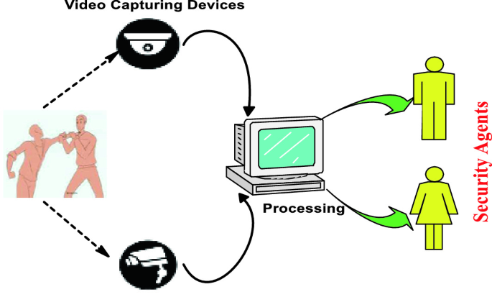

3.4/ CNN-LSTM
Forward Pass
For each batch of video sequences:
CNN Processing: Each frame in a sequence passes through the CNN layers, producing feature maps that represent spatial information.
LSTM Processing: These feature maps are then fed sequentially to the LSTM, which processes the entire frame sequence and learns dependencies between frames.
Output Layer: The final LSTM output goes through fully connected layers, ending with a softmax or sigmoid function to produce probabilities for each class
Model Testing
Once training is complete, the model is evaluated on a test set to assess its performance on completely unseen data.
The test set should ideally represent real-world conditions for violence detection, helping to ensure that the model performs well outside of the training and validation environments.
14

Slide 16
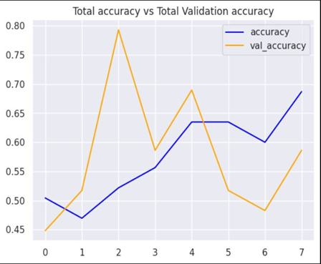
3.4/ CNN-LSTM
Results
Accuracy vs Validation Accuracy
Training Accuracy : The training accuracy gradually increases over the epochs, indicating that the model is learning patterns from the training data.
Accuracy Score is : 0.694
Validation Accuracy : The validation accuracy fluctuates significantly, with a sharp peak around epoch 2 and a drop afterward. This suggests that the model's performance on unseen validation data is inconsistent, which could indicate an issue with generalization.
Observations:
The gap between training and validation accuracy, along with the fluctuations, may indicate overfitting, where the model performs well on the training data but struggles to generalize to new, unseen data.
The peak at epoch 2, followed by a drop, might suggest that the model briefly captured useful patterns but then lost the generalization ability, possibly due to overfitting or under-representation of certain patterns in the dataset.
15

Slide 17
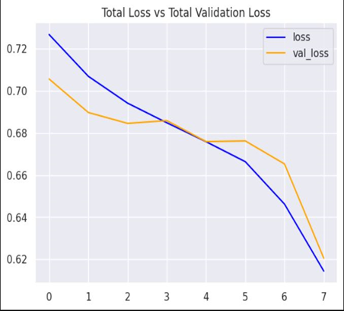
3.4/ CNN-LSTM
Results
Loss vs Validation Loss
Training Loss : The training loss consistently decreases, which is a good sign that the model is learning from the training data and adjusting weights to minimize errors.
Validation Loss: The validation loss also decreases over time but at a slightly slower rate and it briefly increases around epoch 3 before continuing to decline.
Observations:
The decrease in both training and validation loss over time is positive, showing that the model is improving.
However, the initial fluctuation in validation loss could be an early sign of overfitting, and the fact that the validation loss remains higher than the training loss suggests that the model might not be fully capturing the generalizable patterns required for violence detection.
16

Slide 18

3.5/ Video Vision Transformer (ViViT)
Step back : Vision Transformers
Introduction Vision Transformers
18
Google AI blog

Slide 19
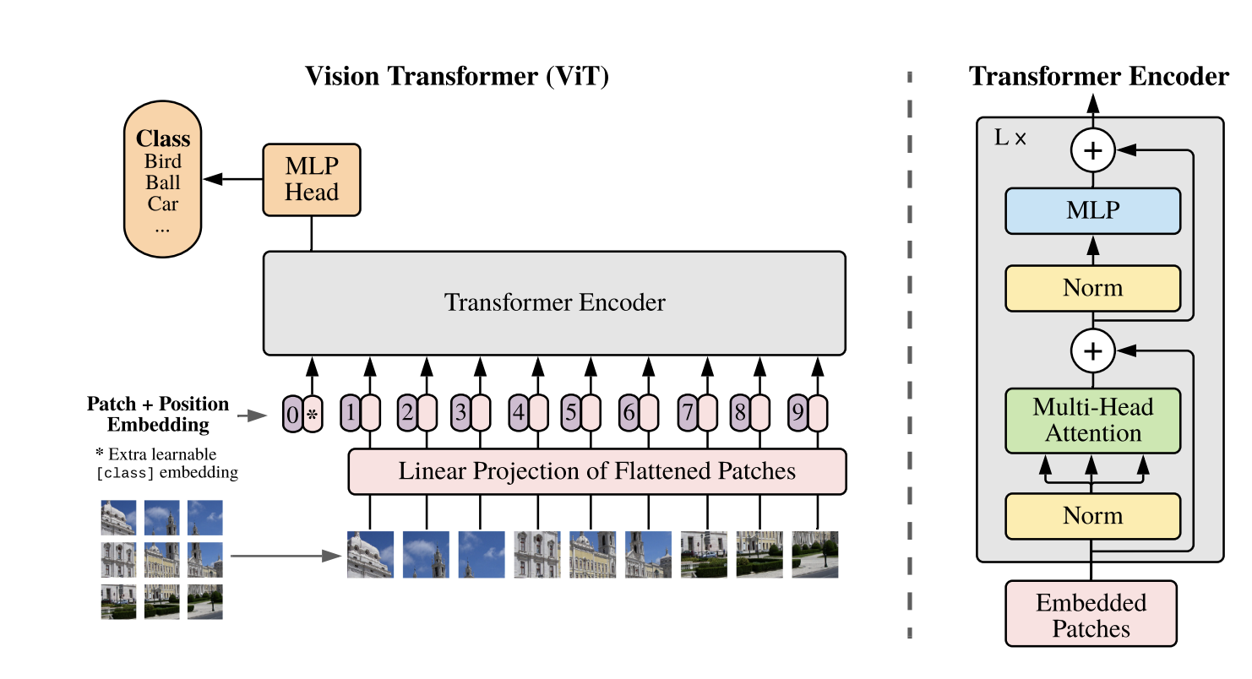
3.5/ Video Vision Transformer (ViViT)
Step back : Vision Transformers
Introduction Vision Transformers
19
Google AI blog​

Slide 20
3.5/ Video Vision Transformer (ViViT)
Introduction Vision Transformers
Vision Transformers (ViTs) are Transformer-based models for CV tasks.
Inspired by the success of Transformers in NLP, particularly BERT and GPT.
Tokenizes input images or video frames into patches and processes them using self-attention.
Why Vision Transformers?
Overcomes limitations of Convolutional Neural Networks (CNNs), such as fixed local receptive fields.
Provides global context understanding from the beginning of processing.
Key Contributions
First Transformer architecture to surpass CNNs in image classification performance.
Effective for large-scale datasets like ImageNet and video datasets like Kinetics.
20

Slide 21


3.5/ Video Vision Transformer (ViViT)
Introduction Video Vision Transformers
Video Vision Transformers (ViViT) extend the concept of Vision Transformers (ViTs) to handle video data.
Inspired by the success of Transformers in natural language processing (NLP) and image classification.
Specifically designed to model spatio-temporal dependencies in video, making them effective for tasks like video classification and action recognition.
21

Slide 22
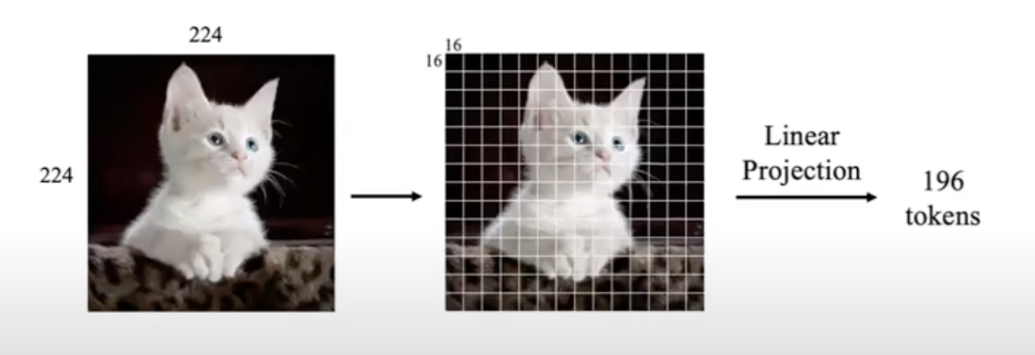
3.5/ Video Vision Transformer (ViViT)
Token in Images
14 patches
14 patches
22

Slide 23
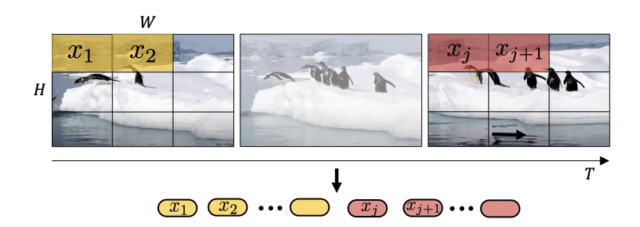
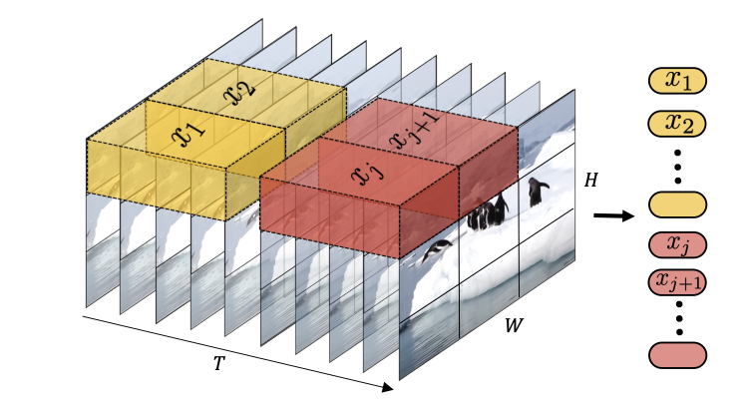
3.5/ Video Vision Transformer (ViViT)
Token in Videos
Uniform frame sampling
Tubelet embedding
Uniformly sample n_{t} frames from the input
Embed each 2D frame independently using the same method as ViT
Concatenate all these tokens together
Fuse spatio-temporal information during tokenisation
Extract non-overlapping, spatio-temporal "tubes" from the input volume
23
Arnab, Anurag, et al. "Vivit: A video vision transformer." Proceedings of the IEEE/CVF international conference on computer vision. 2021.

Slide 24
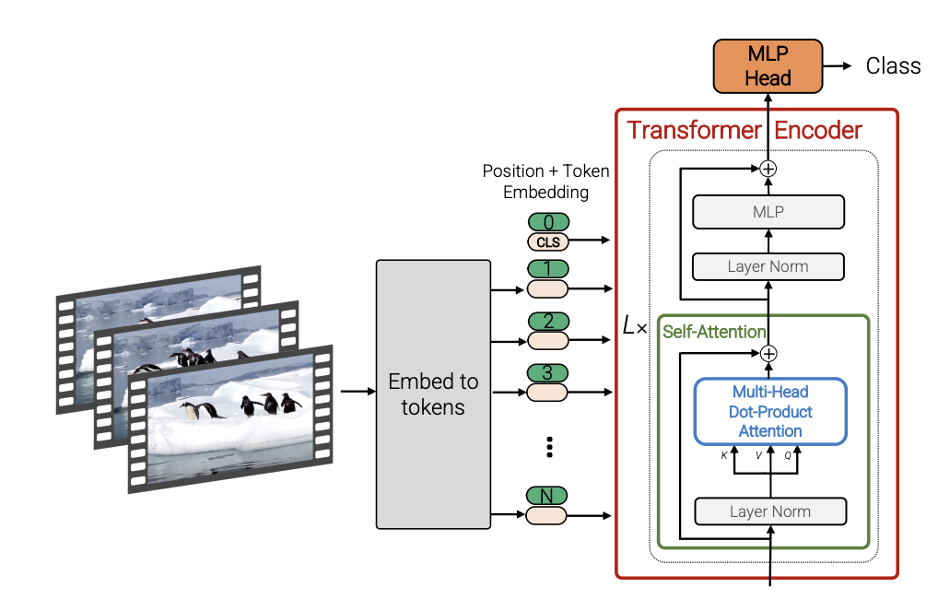
3.5/ Video Vision Transformer (ViViT)
24
Arnab, Anurag, et al. "Vivit: A video vision transformer." Proceedings of the IEEE/CVF international conference on computer vision. 2021.

Slide 25
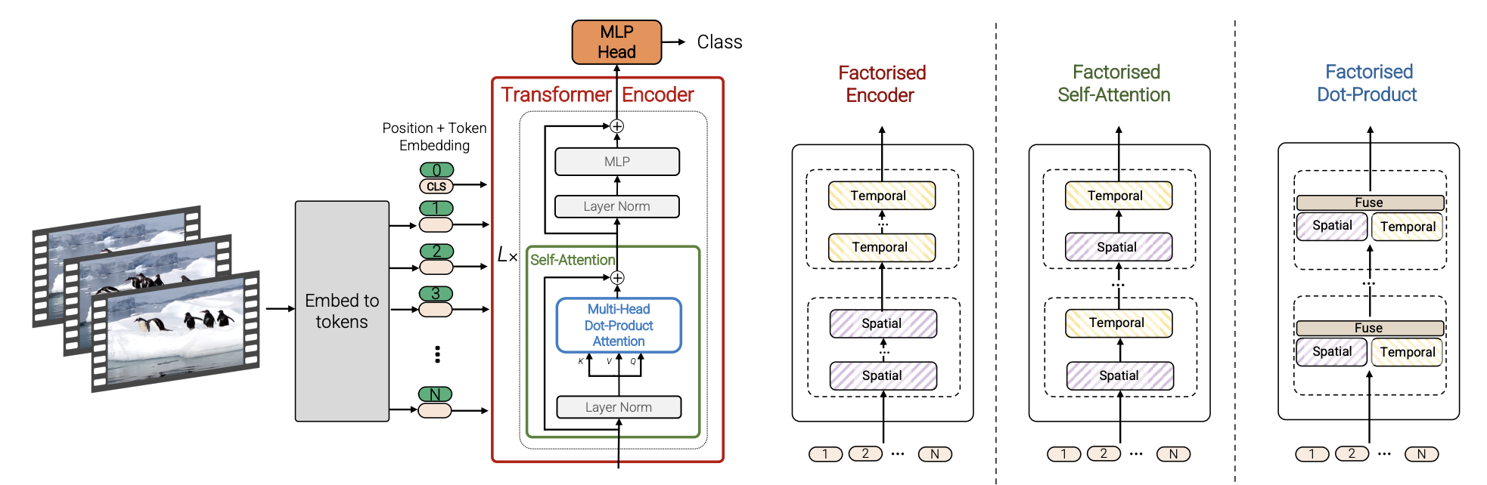
3.5/ Video Vision Transformer (ViViT)
Temporal
Spatial
25
Arnab, Anurag, et al. "Vivit: A video vision transformer." Proceedings of the IEEE/CVF international conference on computer vision. 2021.

Slide 26
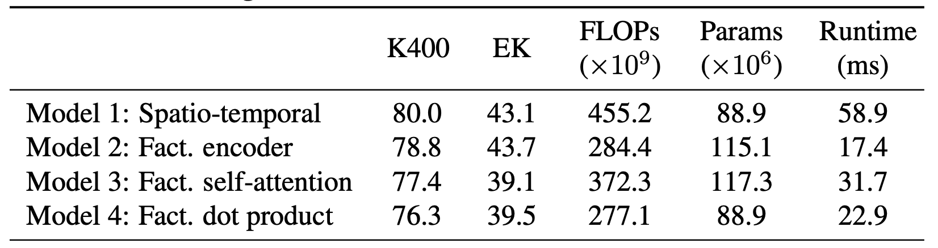
3.5/ Video Vision Transformer (ViViT)
26
Arnab, Anurag, et al. "Vivit: A video vision transformer." Proceedings of the IEEE/CVF international conference on computer vision. 2021.
Notes:
The Kinetics-400 (K400) and Epic-Kitchens (EK) datasets are widely used benchmarks in video understanding and action recognition tasks in computer vision. Here's an overview of both datasets:

Slide 27
3.5/ Video Vision Transformer (ViViT)
Training Process
Data augmentation methods we applied:
Resize, Random Resized, Crop, Horizontal Flip, Vertical Flip, ShiftScale Rotatte, CLAHE
Training and Optimization
Loss: Cross entropy loss
Adam optimizer
Evaluation metric: Accuracy
Pre-trained model: google/vivit-b-16x2-kinetics400
27

Slide 28
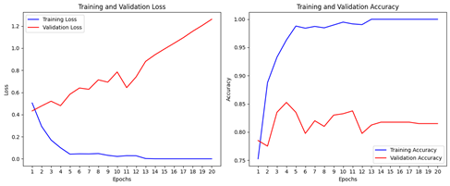
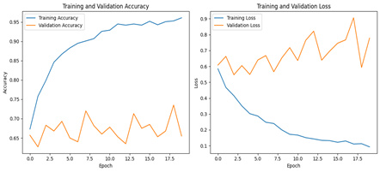
3.5/ Video ViT
Results
Throughout the training epochs, the model demonstrated steady progress in terms of accuracy:
The training accuracy increased rapidly, reaching close to 100%
accuracy after a few epochs. By the 19th epoch, the model’s training accuracy was effectively 100%, indicating that the model could almost perfectly classify the training data
Training and validation logs without data augmentation
Training and validation logs with data augmentation
28

Slide 29
3.5/ Video ViT
Results
Model | # Params | Test Accuracy
ViViT without data augmentation | 86.5 M | 82.5%
ViViT with data augmentation | 86.5 M | 84.75%
29

Slide 30
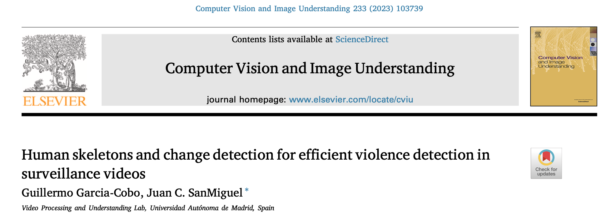
3.6/ Human skeletons and change detection for efficient violence detection in surveillance videos
30

Slide 31
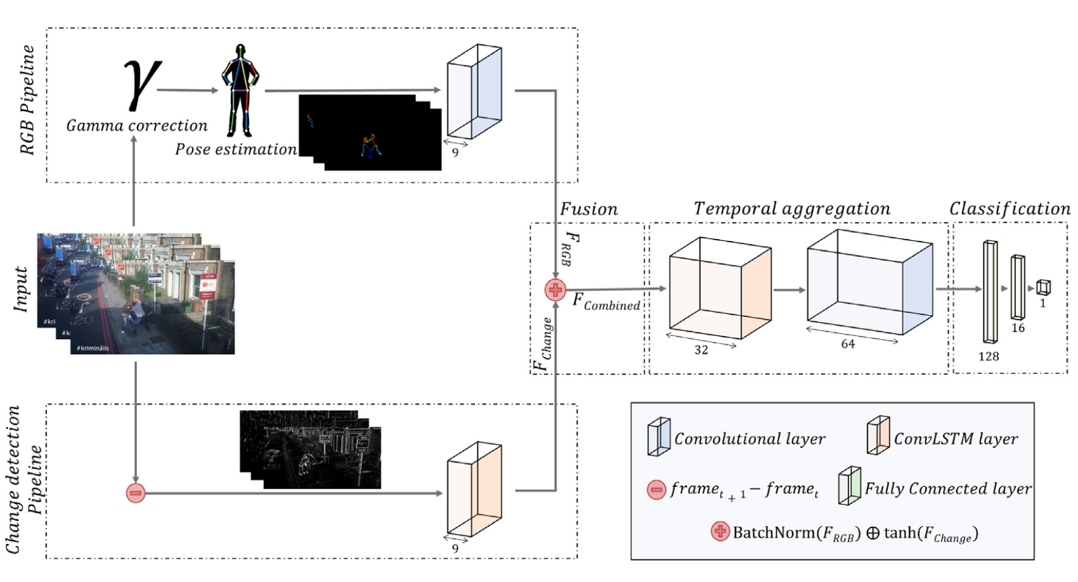
3.6/ Human skeletons and change detection for efficient violence detection in surveillance videos
31
Guillermo Garcia-Cobo, et al. "Human skeletons and change detection for efficient violence detection in surveillance videos"
Notes:
Hypothesis: violence may be identified by the interaction of certain body parts instead of using all the RGB pixels contained in each frame
Extract further temporal information by using a ConvLSTM

Slide 32
3.6/ Human skeletons and change detection for efficient violence detection in surveillance videos
The proposed method integrates two key aspects:
Human Skeleton Representation: Extracts the human body structure (skeletons) from video frames using pose estimation.
Change Detection: Captures inter-frame motion dynamics, focusing on detecting temporal changes like body movements or interactions.
32

Slide 33
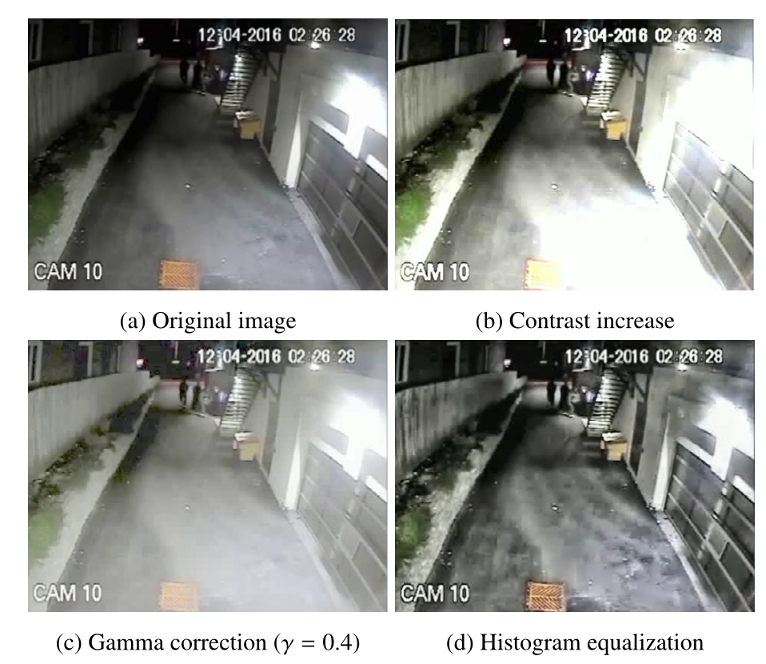
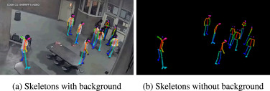
Enhancing Skeletons Extraction
Skeleton Extraction
Skeletons with Background
Skeletons without Background
Skeletons are rendered on a black background for simplicity.
Skeletons' body parts are color-coded for easy differentiation.
33
Notes:
Different parts of the skeletons are colored with specific color - this coloring adds a valuable piece of information

Slide 34
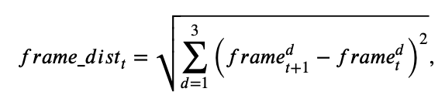
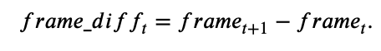
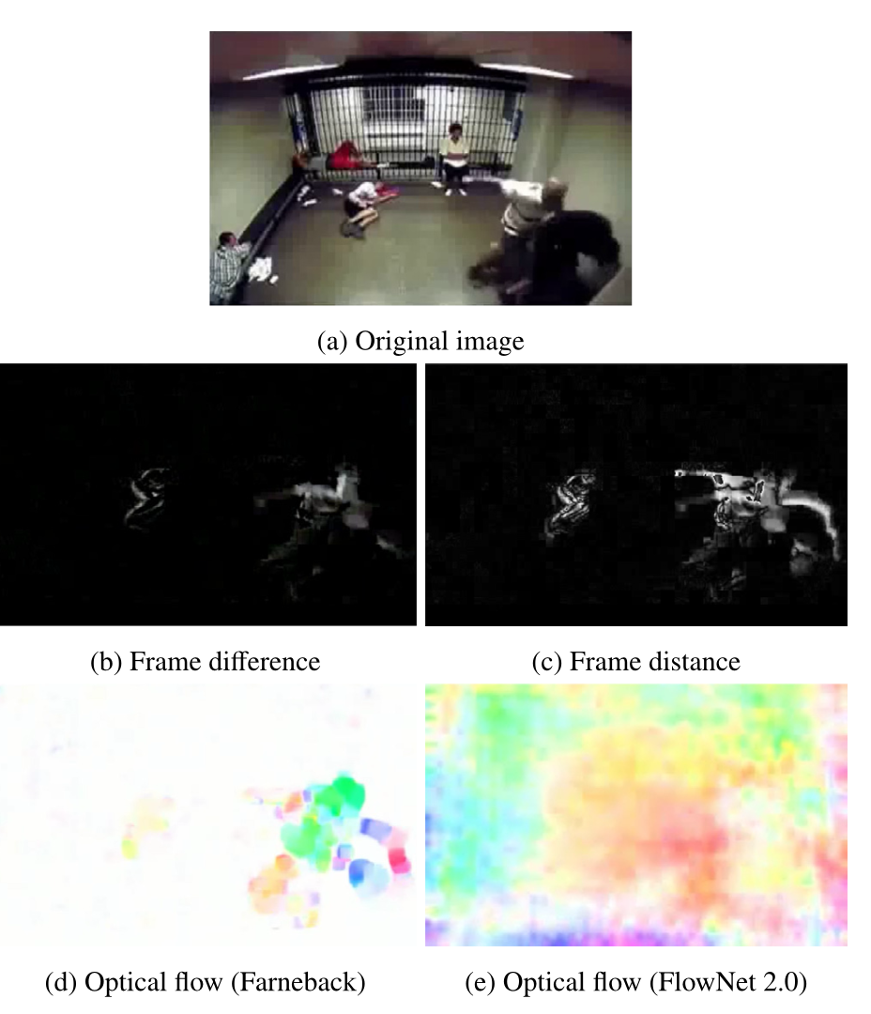
Change detection
34

Slide 35
Video clips are divided into 5-second segments at 30 FPS and later down-sampled to 10 FPS for efficiency.
Frame Preprocessing
Skeleton Extraction
Feature Fusion
Skeleton and change detection features are combined using addition-based fusion.
Temporal Aggregation
Frames are resized to standardized dimensions (100x100 pixels).
Change Detection
RGB pipeline & Change Detection pipeline
Conv-LSTM processes aggregated features to predict violence.
Video Sampling

Slide 36
3.6/ Human skeletons and change detection for efficient violence detection in surveillance videos
Fusion and Temporal Aggregation
Fusion Approach:
Combines skeleton and change detection pipelines to leverage both spatial and temporal features.
Novel Addition-Based Fusion:
Uses BatchNorm to standardize skeleton features.
Applies tanh scaling to temporal features for effective integration.
Temporal Aggregation:​
ConvLSTM: Processes combined features across frames to capture temporal dependencies.​
35

Slide 37
3.6/ Human skeletons and change detection for efficient violence detection in surveillance videos
Processing Video and Frames
Video Processing:
Each video clip (5 seconds) is sampled at 30 FPS, yielding 150 frames.
Frames are uniformly subsampled to 50 frames per clip for efficiency (reducing FPS to 10).
Frame Preprocessing:
Frames are resized to 100x100 resolution to minimize computational load.
Skeleton rendering and change detection are applied to processed frames.
36

Slide 38
3.6/ Human skeletons and change detection for efficient violence detection in surveillance videos
Experiments
Model | Train accuracy | Validation accuracy | Validation Accuracy (Reproduce)
RGB frames | 75.06 % | 78.5 % | 78.12 %
Skeletons with background | 73.5% | 80% | 84.9 %
Skeletons without background | 87.88 % | 84.75 % | 85.68 %
37
Guillermo Garcia-Cobo, et al. "Human skeletons and change detection for efficient violence detection in surveillance videos"
Notes:
Original videos & 78.12\% \\
OpenPose\ no_back & 85.68\% \\
Openpose back & 84.90\% \\

Slide 39
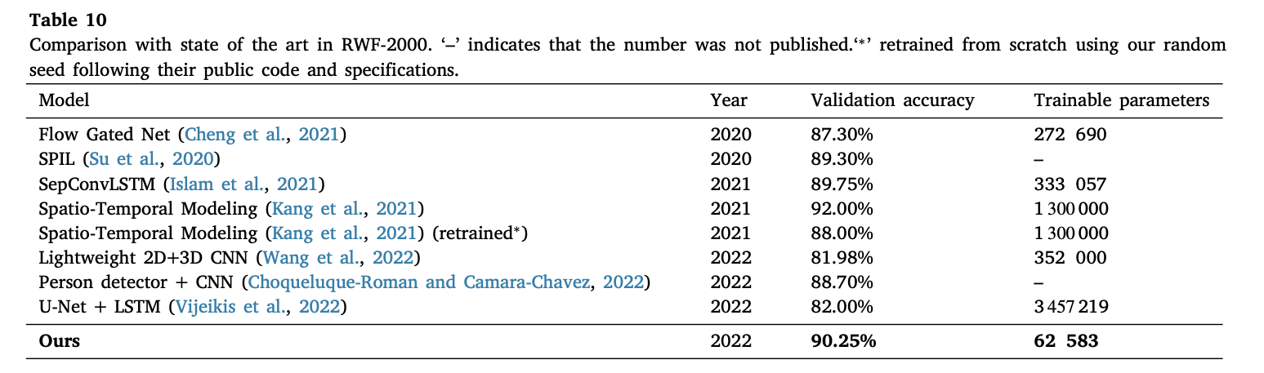
3.6/ Human skeletons and change detection for efficient violence detection in surveillance videos
Experiments
 | Train Accuracy | Test Accuracy
Author results | 92.37 % | 90.25 %
Our reproduce results | 92.68 % | 87.75 %
38
Guillermo Garcia-Cobo, et al. "Human skeletons and change detection for efficient violence detection in surveillance videos"
Notes:
Original videos & 78.12\% \\
OpenPose\ no_back & 85.68\% \\
Openpose back & 84.90\% \\

Slide 40
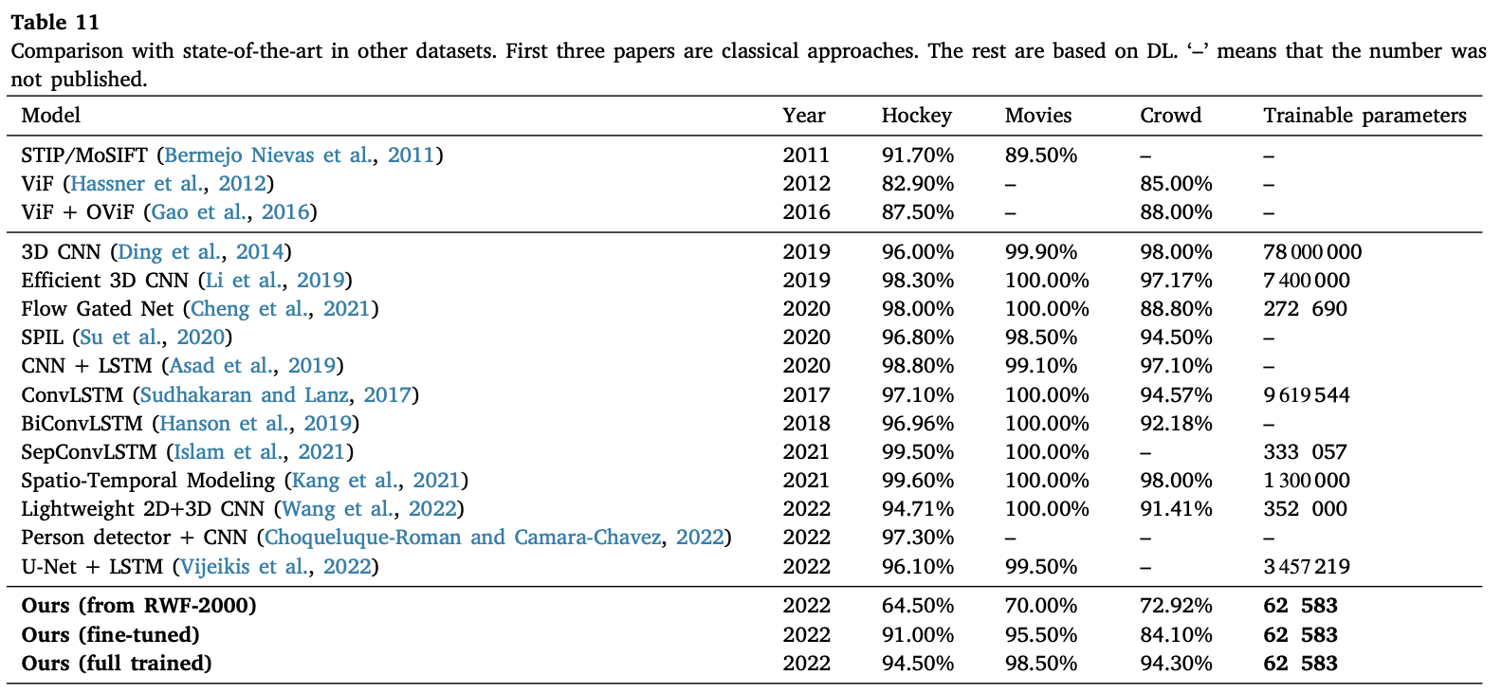
3.6/ Human skeletons and change detection for efficient violence detection in surveillance videos
Experiments
39
Guillermo Garcia-Cobo, et al. "Human skeletons and change detection for efficient violence detection in surveillance videos"

Slide 41
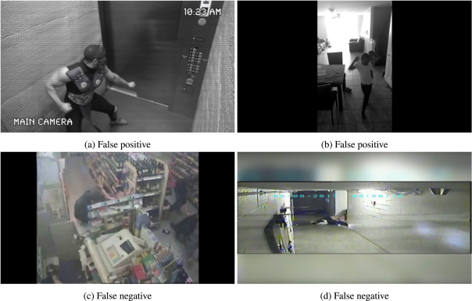
3.6/ Human skeletons and change detection for efficient violence detection in surveillance videos
Efficiency and qualitative analysis
Qualitative analysis reveals that false positives arise from ambiguous non-violent motions, while false negatives occur with occluded violence.
40

Slide 42
3.6/ Human skeletons and change detection for efficient violence detection in surveillance videos
Insights and Comments on the Paper - Strengths
Innovative Dual-Pipeline Design:
Combines human skeleton features with temporal dynamics using frame difference, addressing both spatial and temporal aspects of violence detection.
Provides a significant balance between accuracy and computational efficiency, making it suitable for real-time applications.
Efficiency and Scalability: Processes videos at a reduced frame rate (10 FPS) without losing critical temporal information, ensuring fast runtime.
Robust Preprocessing: Gamma correction and black-background skeleton rendering improve noise resistance and focus the model on essential body movements.
Impressive Results: Achieves state-of-the-art accuracy (90.25%) on the RWF-2000 dataset, demonstrating the effectiveness of fusing pose estimation with temporal changes.
Generalization Capability: The proposed method generalizes well across different datasets, showing adaptability to varied violence scenarios.
41

Slide 43
3.6/ Human skeletons and change detection for efficient violence detection in surveillance videos
Insights and Comments on the Paper - Weakness
Dependency on Pose Estimation:
Relies heavily on the accuracy of pose extraction. Any inaccuracies in skeleton detection (e.g., due to occlusion, crowding, or lighting) can adversely affect the performance.
False Positives/Negatives:
False positives may arise in non-violent but dynamic movements (e.g., sports activities).
False negatives are common in occlusion-heavy or low-contrast scenes, where pose estimation or temporal dynamics detection might fail.
42

Slide 44
4/ Challenges
Data Availability: Acquiring diverse datasets of violent and non-violent acts in various settings (indoors, outdoors, crowd density, lighting conditions).
Some challenges in dataset such as:
Only part of the person appears in the picture
Crowds and chaos
Transient Action
Low resolution
Real-time Processing: Ensuring low latency without compromising accuracy.
False Positives: Minimizing the number of false alerts triggered by non-violent actions.
Computational Resources: Training complex models for Video and transformers requires substantial computational power.
43

Slide 45


5/ Conclusion
Model | Test accuracy | # Params
CNN-LSTM | 69.4 % | 34.2 M
ViViT | 84.75 % | 86.5 M
Human Skeleton and change detection | 90.25% (87.75% our experiments) | 62 583
44

Slide 46
5/ Conclusion
Performance Comparison:
CNN-LSTM: Achieved 69.4 % test accuracy with 34.2M parameters. It effectively extracted spatial and temporal features but struggled with generalization and accuracy on noisy datasets.
ViViT (Video Vision Transformer): Reached 84.75% test accuracy with 86.5M parameters, excelling in modeling complex spatio-temporal dependencies. Data augmentation boosted performance but required high computational resources.
Human Skeleton and Change Detection: Delivered the highest test accuracy of 90.25% (87.75% in reproduced experiments) with 62.6M parameters. It effectively leveraged spatial (skeleton) and temporal (motion) features, proving efficient and robust in real-world scenarios.
Key Insights:
Human Skeleton Model: Balanced accuracy and efficiency, ideal for real-time violence detection.
ViViT: Excellent at capturing complex relationships but resource-intensive.
CNN-LSTM: Struggled with overfitting and generalization, limiting its adaptability.
45
Notes:
Skeleton-based models showed superior generalization across various scenarios, especially when noisy backgrounds and occlusions were minimized. However, dependency on pose estimation led to occasional errors in crowded or occluded settings.
ViViT achieved high accuracy, but its reliance on large computational resources highlighted the importance of balancing accuracy with practicality for real-time applications.

Slide 47
5/ Conclusion - What we had done through this project
Dataset Preparation
Utilized the RWF-2000 dataset, comprising 2,000 video clips equally divided into violent and non-violent classes.
Addressed challenges such as:
Low resolution, poor lighting, and motion blur.
Applied preprocessing:
Frame extraction and resizing.
Skeleton rendering for focus on body movements.
Data augmentation to improve diversity.
Model Implementation - Implemented and evaluated three models:
CNN-LSTM: For sequential analysis of spatial and temporal features.
ViViT: To capture long-range spatio-temporal relationships.
Human Skeleton and Change Detection: For a robust and efficient dual-pipeline approach.
46

Slide 48
5/ Conclusion - What we had done through this project
Performance Evaluation
Accuracy.
Computational efficiency (# parameters).
Generalization to noisy, real-world scenarios.
Achieved state-of-the-art accuracy of 90.25% with the Human Skeleton model.
Insights Gained
Identified trade-offs between model complexity, accuracy, and real-time applicability.
Highlighted the importance of efficient preprocessing and feature integration for practical deployment.
47

Slide 49

THANK YOU
FOR LISTENING

